Slide 1
Module 2
Tables

Slide 2
Announcements

Slide 3
Top Box Office Hit
The highest grossing movie of all time is:
Avatar
Jaws
Titanic
Star Wars
Star Wars: The Force Awakens

Slide 4
Python

Slide 5
Programming Languages
Python is popular both for data science & general software development
Mastering the language fundamentals is critical
Learn through practice, not by reading or listening
Follow along: datahub.berkeley.edu
(Demo)

Slide 6
Names

Slide 7
Assignment Statements
hours_per_wk = 24*7
Name
Any expression
Statements don't have a value; they perform an action
An assignment statement changes the meaning of the name to the left of the = symbol
The name is bound to a value (not an equation)

Slide 8
Call Expressions

Slide 9
Anatomy of a Call Expression
What function to call
Argument to the function
f ( 27)
"Call f on 27."

Slide 10
Anatomy of a Call Expression
What function to call
First argument
Second argument
max ( 15 , 27 )

Slide 11
Tables

Slide 12
Table Structure
We organize our data in tables
A Table is a sequence of labeled columns
Data within a column should be of the same "type"
Label
Name | Code | Area (m2)
California | CA | 163696
Nevada | NV | 110567
Row
(Demo)
Column

Slide 13
Table Operations
t.select(label) - constructs a new table with just the specified columns
t.sort(label) - constructs a new table, with rows sorted by the specified column
(Demo)

Slide 14
The where method
t.where(label, condition) - constructs a new table with just the rows that match the condition
(Demo)

Slide 15
Ways to create a table
Table.read_table(filename) - reads a table from a spreadsheet
Table() - an empty table
and...

Slide 16
Arrays → Tables
Table().with_column(label, data) - creates a table with a single column; data is an array
Table().with_columns(label1, data1, ...) - creates a table, with an array of data for each column

Slide 17
Table Methods
Creating and extending tables:
Table().with_columns and Table.read_table
Finding the size: num_rows and num_columns
Referring to columns: labels, relabeling, and indices
labels and relabeled; column indices start at 0
Accessing data in a column
column takes a label or index and returns an array
Using array methods to work with data in columns
item, sum, min, max, and so on
Creating new tables containing some of the original columns:
select, drop

Slide 18
Examples
The table students has columns Name, ID, and Score.
Write one line of code that evaluates to:
A table consisting of only the column labeled Name
students.select('Name')
b) The largest score
students.column('Score').max()
max(students.column('Score'))

Slide 19
Module 2
Expressions

Slide 20
Announcements

Slide 21
Arithmetic

Slide 22
Arithmetic Operators
Operation | Operator | Example | Value
Addition | + | 2 + 3 | 5
Subtraction | - | 2 - 3 | -1
Multiplication | * | 2 * 3 | 6
Division | / | 7 / 3 | 2.66667
Remainder | % | 7 % 3 | 1
Exponentiation | ** | 2 ** 0.5 | 1.41421
(Demo)

Slide 23
Ints and Floats
Python has two real number types
int: an integer of any size
float: a number with an optional fractional part
An int never has a decimal point; a float always does
A float might be printed using scientific notation
Three limitations of float values:
They have limited size (but the limit is huge)
They have limited precision of 15-16 decimal places
After arithmetic, the final few decimal places can be wrong

Slide 24
Arithmetic Question
Rank the results of the following expressions in order from least to greatest
3 * 10 ** 10
10 * 3 ** 10
(10 * 3) ** 10
10 / 3 / 10
10 / (3 / 10)
30000000000
590490
590490000000000
0.33333333333333337
33.333333333333336

Slide 25
Exponential Growth

Slide 26
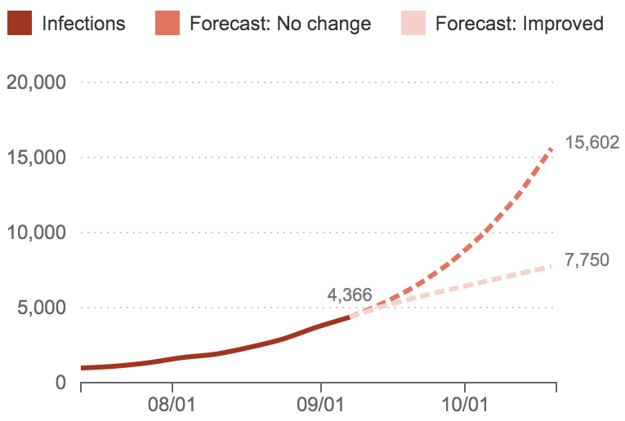
Ebola Epidemic, Sept. 2014
A Frightening Curve: How Fast Is The Ebola Outbreak Growing?
"It's spreading and growing exponentially," President Obama said.
"This is a disease outbreak that is advancing in an exponential fashion," said Dr. David Nabarro, who is heading the U.N.'s effort against Ebola.
http://www.npr.org/sections/goatsandsoda/2014/09/18/349341606/why-the-math-of-the-ebola-epidemic-is-so-scary
Source: Columbia Prediction of Infectious Diseases, World Health Organization

Slide 27
Growth Rate
The rate of increase per unit time
After one time unit, a quantity x growing at rate g will be
x * (1 + g)
After t time units, a quantity x growing at rate g will be
x * (1 + g) ** t
If after and before are measurements of the same quantity taken t time units apart, then the growth rate is
(after/before) ** (1/t) - 1
(Demo)

Slide 28
Arrays

Slide 29
Arrays
An array contains a sequence of values
All elements of an array should have the same type
Arithmetic is applied to each element individually
When two arrays are added, they must have the same size; corresponding elements are added in the result
A column of a table is an array
(Demo)

Slide 30
Ranges

Slide 31
Ranges
A range is an array of consecutive numbers
np.arange(end): An array of increasing integers from 0 up to end
np.arange(start, end): An array of increasing integers from start up to end
np.arange(start, end, step): A range with step between consecutive values
The range always includes start but excludes end

Slide 32
Strings

Slide 33
Text and Strings
A string value is a snippet of text of any length
'a'
'word'
"there can be 2 sentences. Here's the second!"
Strings that contain numbers can be converted to numbers
int('12')
float('1.2')
Any value can be converted to a string
str(5)
(Demo)

Slide 34
Discussion Question
Assume you have run the following statements
x = 3
y = '4'
z = '5.6'
What's the source of the error in each example?
x + y
x + int(y + z)
str(x) + int(y)
str(x, y) + z

Slide 35
Strings

Slide 36
Text and Strings
A string value is a snippet of text of any length
'a'
'word'
"there can be 2 sentences. Here's the second!"
Strings that contain numbers can be converted to numbers
int('12')
float('1.2')
Any value can be converted to a string
str(5)
(Demo)

Slide 37
Discussion Question
Assume you have run the following statements
x = 3
y = '4'
z = '5.6'
What's the source of the error in each example?
x + y
x + int(y + z)
str(x) + int(y)
str(x, y) + z

Slide 38
Minard's Map

Slide 39
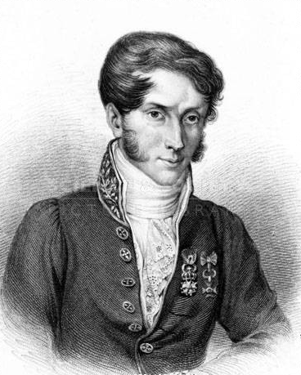
Charles Joseph Minard, 1781-1870
French civil engineer who created one of the greatest graphs of all time
Visualized Napoleon's 1812 invasion of Russia, including
the number of soldiers
the direction of the march
the latitude and longitude of each city
the temperature on the return journey
Dates in November and December

Slide 40
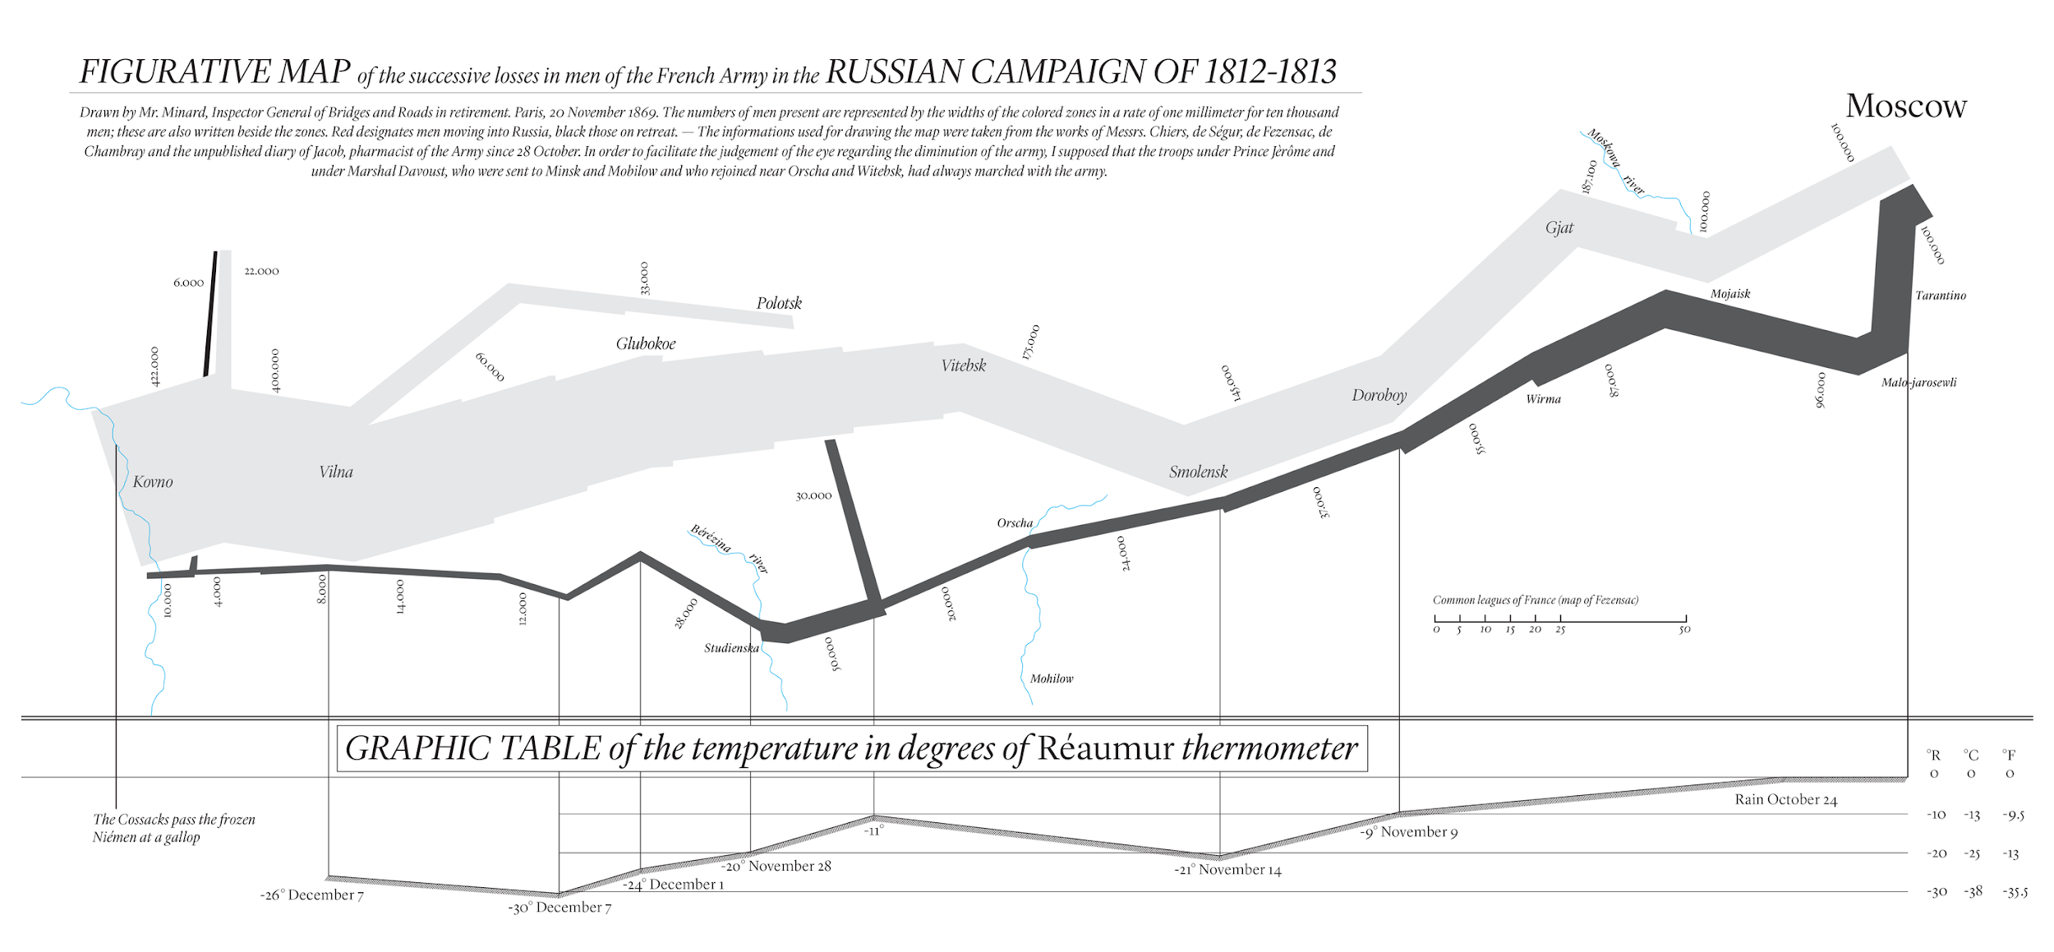
Visualization of 1812 March

Slide 41
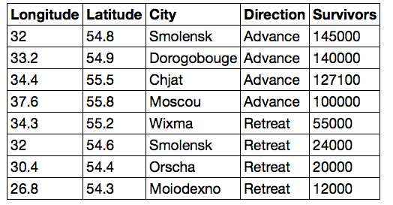
Different types of data
float:
decimal number
string:
text
int: integer

Slide 42
Lists

Slide 43
Lists are Generic Sequences
A list is a sequence of values (just like an array), but the values can all have different types
[2+3, 'four', Table().with_column('K', [3, 4])]
If you create a table column from a list, it will be converted to an array automatically
(Demo)

Slide 44
Take

Slide 45
Take Rows, Select Columns
The select method returns a table with only some columns
The take method returns a table with only some rows
Rows are numbered, starting at 0
Taking a single number returns a one-row table
Taking a list of numbers returns a table as well
(Demo)

Slide 46
The where method
t.where(label, condition) - constructs a new table with just the rows that match the condition
(Demo)

Slide 47
Manipulating Rows
t.sort(column) sorts the rows in increasing order
t.take(row_numbers) keeps the numbered rows
Each row has an index, starting at 0
t.where(column, are.condition) keeps all rows for which a column's value satisfies a condition
t.where(column, value) keeps all rows containing a certain value in a column

Slide 49
Module 2
Census

Slide 50
Announcements

Slide 51
Tables Review

Slide 52
Table Structure
A Table is a sequence of labeled columns
Labels are strings
Columns are arrays, all with the same length
Label
Name | Code | Area (m2)
California | CA | 163696
Nevada | NV | 110567
Row
Column

Slide 53
Table Methods
Creating and extending tables:
Table().with_columns and Table.read_table
Finding the size: t.num_rows and t.num_columns
Referring to columns: labels, relabeling, and indices
t.labels and t.relabeled; column indices start at 0
Accessing data in a column
t.column takes a label or index and returns an array
Using array methods to work with data in columns
a.item(row_index) returns a value in an array
a.sum(), a.min(), a.max() or sum(a), min(a), max(a)
Creating new tables containing some of the original columns:
select, drop

Slide 54
Manipulating Rows
t.sort(column) sorts the rows in increasing order
t.take(row_numbers) keeps the numbered rows
Each row has an index, starting at 0
t.where(column, are.condition) keeps all rows for which a column's value satisfies a condition
t.where(column, value) keeps all rows for which a column's value equals some particular value
t.with_row makes a new table that has another row
(Demo)

Slide 55
Discussion Questions
The table nba has columns NAME, POSITION, and SALARY.
Create an array containing the names of all point guards (PG) who make more than $15M/year
nba.where(1, 'PG').where(2, are.above(15)).column(0)
b) After evaluating these two expressions in order, what's the result of the second one?
nba.with_row(['Samosa', 'Mascot', 100])
nba.where('NAME', are.containing('Samo'))

Slide 56
Census Data

Slide 57
The Decennial Census
Every ten years, the Census Bureau counts how many people there are in the U.S.
In between censuses, the Bureau estimates how many people there are each year.
Article 1, Section 2 of the Constitution:
“Representatives and direct Taxes shall be apportioned among the several States … according to their respective Numbers …”

Slide 58
Analyzing Census Data
Leads to the discovery of interesting features and trends in the population
(Demo)

Slide 59
Census Table Description
Values have column-dependent interpretations
The SEX column: 1 is Male, 2 is Female
The POPESTIMATE2010 column: 7/1/2010 estimate
In this table, some rows are sums of other rows
The SEX column: 0 is Total (of Male + Female)
The AGE column: 999 is Total of all ages
Numeric codes are often used for storage efficiency
Values in a column have the same type, but are not necessarily comparable (AGE 12 vs AGE 999)
http://www2.census.gov/programs-surveys/popest/datasets/2010-2015/national/asrh/nc-est2015-agesex-res.pdf

